Slide 1

FOREST RANGER
BACHELOR OF TECHNOLOGY
in
Information Technology
BY
ASHISH RANJAN ( Univ Roll no. - 13000220063)
RUPANTAR CHOWDHURY ( Univ Roll no. - 13000220064)
RAHUL KUMAR GORAI ( Univ Roll no. – 13000220065)
AYUSHI SENGUPTA ( Univ Roll no. – 13001620104)
Under the Supervision of
Dr. Anirban Goswami and Mr. Subha Koley
and Prof. Subhajit Bhowmick
Department of Information Technology
Techno Main Salt Lake.
Kolkata -700091.

Slide 2
OBJECTIVE
To Develop Early Warning Systems: Create systems that can detect forest fires and deforestation in their early stages, allowing for timely intervention and mitigation efforts.
To Minimize Environmental Impact: Implement measures to reduce the environmental impact of forest fires and deforestation, preserving biodiversity and ecosystem integrity.
To Enhance Public Safety: Improve safety measures for communities living near forests by providing early warnings and evacuation protocols in case of emergencies.
To Promote Sustainable Forest Management: Encourage sustainable practices and resource management strategies to prevent future occurrences of forest fires and deforestation.
To Foster Collaboration: Foster collaboration among stakeholders, including government agencies, research institutions, and local communities, to address the complex challenges posed by forest disasters effectively.

Slide 3
PROBLEM DEFINITION
One of the central challenges contributing to the degradation of forest ecosystems is the use of insufficient and outdated methods for monitoring.
The Forest Ranger project addresses the pressing issue of deteriorating forest ecosystems due to rampant forest fires, illegal logging, and inadequate monitoring.
The project aims to address this critical gap by harnessing advanced technologies, including satellite imagery, sensor networks, and artificial intelligence. These technologies are integrated to enable real-time, data-driven decision-making processes.
The critical problem definition revolves around the need for a holistic and technologically empowered approach to enhance the efficiency and effectiveness of forest management, ultimately ensuring the long-term health and sustainability of our vital forested ecosystems.

Slide 4
Literature Review
Sakr and George (2021): Analyzed AI-based forest fire prediction methods using previous weather conditions.
Cortez (2020): Proposed automatic tools using local sensors from meteorological stations to predict forest fires.
D. Kinaneva et al. (2019): Developed a UAV-based platform for constant surveillance of fire-prone areas.
Ghali et al. (2018): Applied Deep Learning methods for early wildfire detection using aerial images.
Soto Vega (2017): Investigated a weak supervised method for deforestation mapping with high class imbalance.

Slide 5
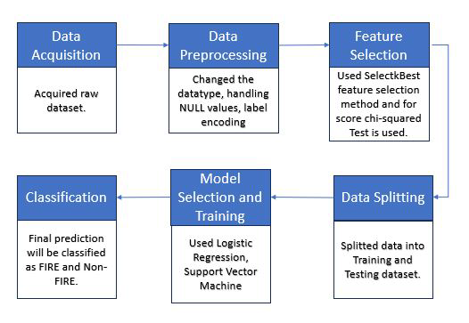
Proposed Methodology ( Part 1)
Data acquisition and preprocessing : Collecting and preparing the data from the forest fire dataset.
Feature selection : Selecting the subset of most appropriate and relevant features to be used in model building.
Splitting data : Dividing the dataset into separate subsets that is training and testing dataset.
Model selection : Selecting the model based on accuracy score.
Classification : Predicting the result in terms of fire or not-fire.
Fig 1 : Steps involved in Forest Fire Prediction

Slide 6
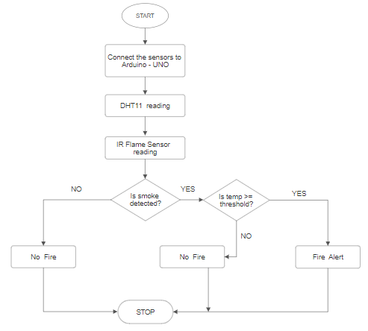
Proposed Methodology ( Part 2 )
Data Collection
Sensors: Used DHT11 sensors to collect humidity and temperature data. IR Flame Sensor to detect smoke.
Oxygen Data: Collected from an existing dataset.
Data Storage: Securely store data in Firebase Realtime Repository.
App Development: Created using HTML, CSS, and Flask to input temperature, humidity, and oxygen values.
Fig 2: Flow Diagram of Fire Detection System

Slide 7
Proposed Methodology ( Part 3)
Deforestation Detection
Data Collection: Gather satellite images and ground data from deforested and non-deforested areas.
Preprocessing: Normalize images, remove noise, and perform data augmentation.
Model Architecture: Use a Convolutional Neural Network (CNN) with multiple convolutional layers, pooling layers, and fully connected layers.
Training: Train the model on labeled data with known deforestation outcomes.
Validation: Validate the model with a separate set of data to ensure accuracy.
Deforestation Probability: The model outputs the probability of deforestation in a given region.
Pollution Probability: The model also estimates pollution probability based on detected deforestation.

Slide 8
Experimental Details
Dataset:
Algerian Forest Fires dataset from UCI
Forest fire dataset from Indian Forest Fire Incident
Description: Collected over 250+ data points from the mentioned datasets.
These datasets include critical information such as temperature, humidity, and fire occurrences in different regions.
Classification :
Fig 3 : Classification of the dataset
Software Environment
Technologies Used: HTML ,CSS, Flask for Web application
CNN algorithm for detect deforestation
Firebase for storing datasets
Hardware Setup for Alerting Messages and Calls:
Parts Required: Arduino UNO, SIM800L GSM Module, IR Flame Sensor Module, Buzzer, 18650 3.7v Rechargeable Battery (3)

Slide 9
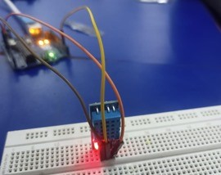
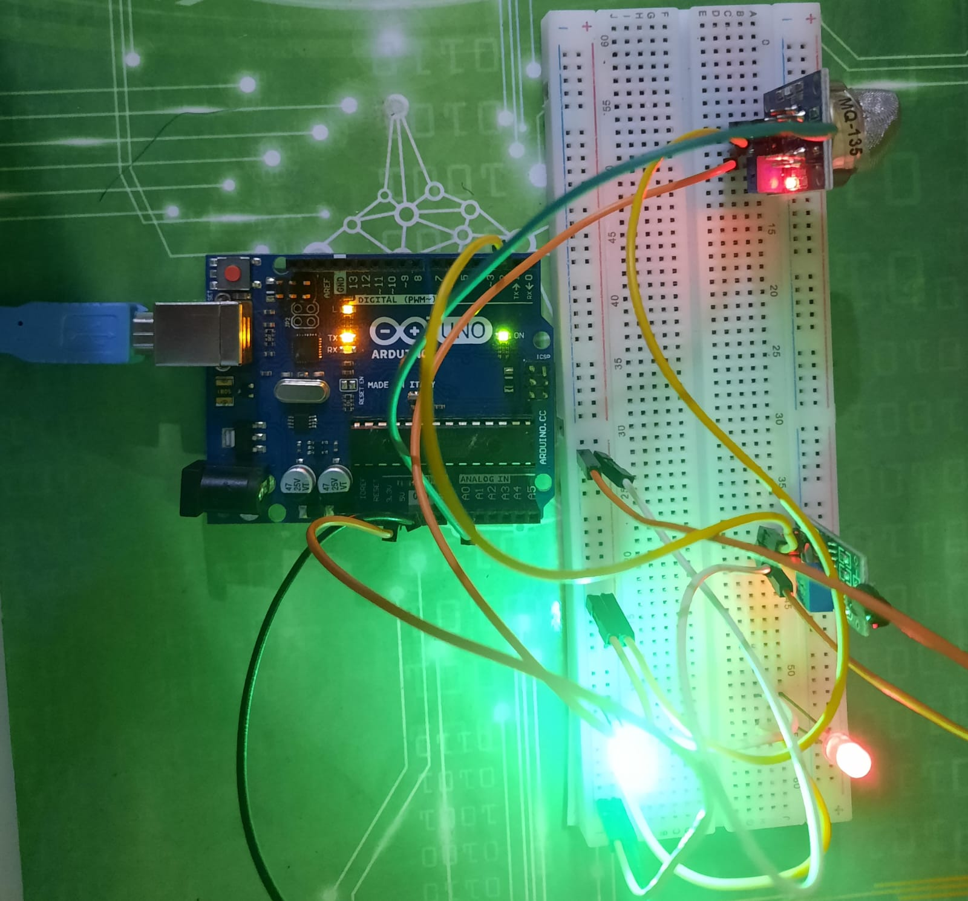
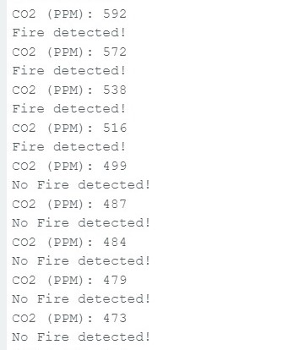
Experimental Details
The setup and circuit design of a DHT11 sensor with Arduino UNO and IR Flame sensor with a SIM800L GSM module and an alert buzzer is shown in the diagrams below.
Fig 4 : DHT11 with Arduino
Fig 5 : Flame sensor with buzzer
Fig 6: Output of Arduino IDE

Slide 10
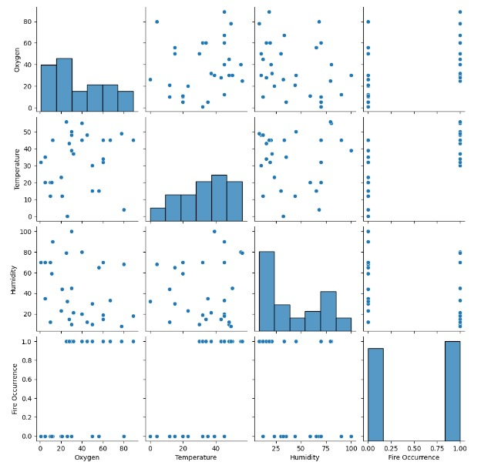
Experimental RESULTS
Based on the SelectKBest algorithm, we identified the top 3 features out of the initial 15 for predicting forest fires.
These selected features were temperature, humidity, and oxygen level, chosen not only through statistical analysis but also by referencing environmental studies and wildfire research.
With these top 3 features, we trained our models, aiming for both high performance and practical applicability
Fig 7 : Pairplot for the top features

Slide 11
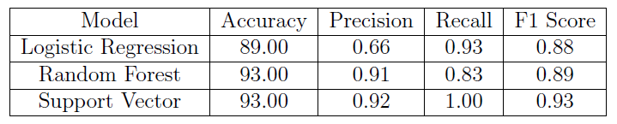
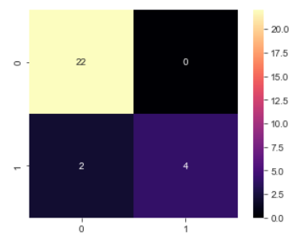
RESULTS AND ANALYSIS
After running the data through all of the models, it was discovered that Support Vector Machine showed the highest accuracy of 93% as shown in the table given below.
Fig 8: Model Evaluation Metrics
In the given confusion matrix, yellow part is true positive (TP) and purple is true negative (TN) and upper black is false positive (FP) and lower violet part is false negative (FN).
Fig 9: Confusion matrix of SVM

Slide 12
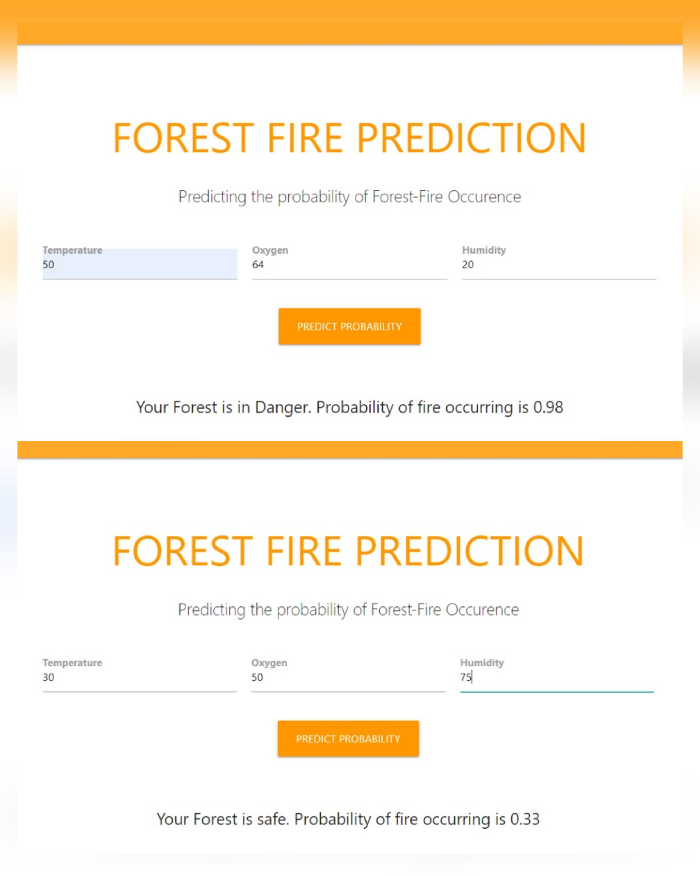
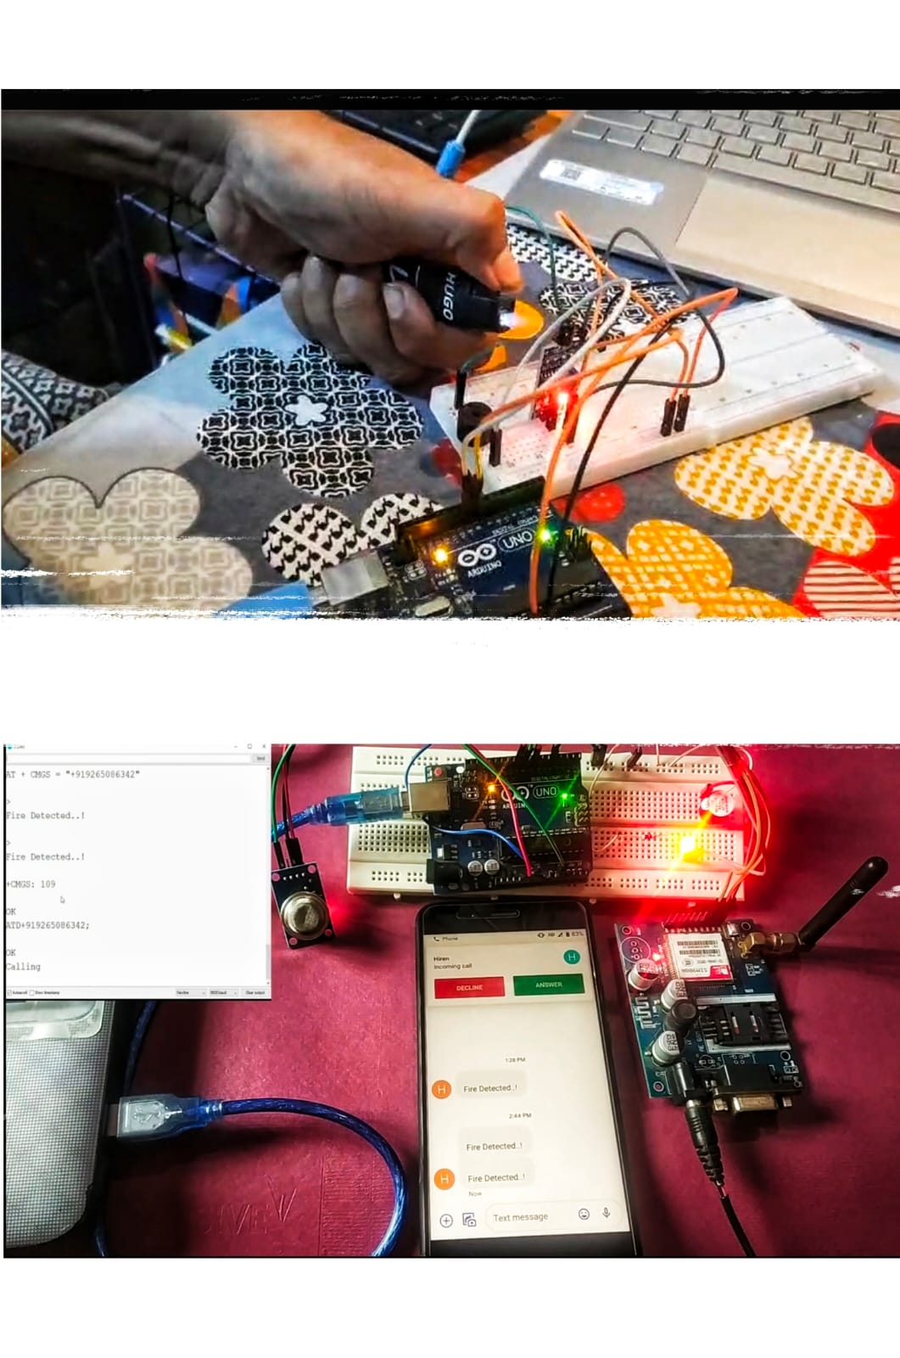
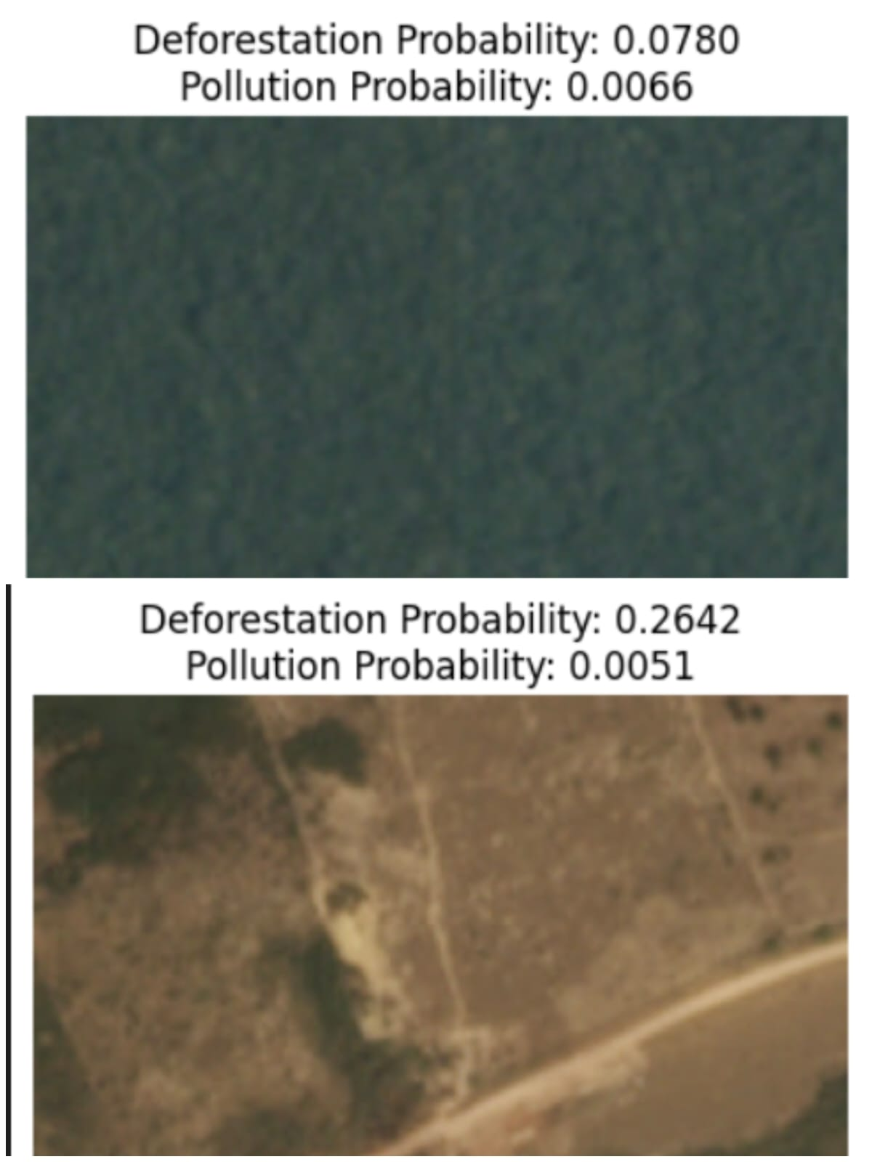
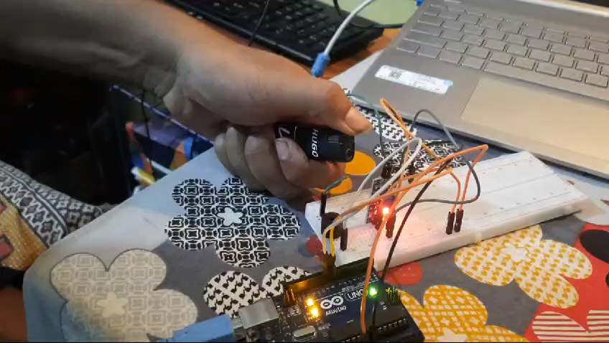
RESULTS AND ANALYSIS
Forest Fire Prediction:
GSM Alert System:
Deforestation Detection:

Slide 13
CONCLUSION
Integration of Multi-disciplinary Approaches: Our project combines environmental science, sensor technology, AI, and IoT to create a comprehensive forest monitoring system.
Real-time Data Utilization: By leveraging real-time data from sensors and Firebase, our system provides up-to-the-minute information crucial for early fire detection and prevention.
Scalability and Flexibility: The GSM-based fire alert system and CNN algorithms are designed to be scalable, enabling deployment in various forest environments and terrains.
Enhanced Accuracy and Reliability: The use of multiple data sources (sensors, meteorological data, aerial images) and advanced algorithms (AI, CNN) enhances the accuracy and reliability of our predictions and detections.
Proactive Disaster Management: Early detection and rapid response mechanisms help in mitigating forest fires and deforestation, thereby reducing environmental damage and protecting wildlife.
User-Friendly Solutions: The mobile app and GSM alert system are user-friendly, ensuring easy adoption by forest rangers and local authorities.
Conservation and Sustainability: By addressing both forest fires and deforestation, our project contributes to long-term forest conservation and sustainability efforts.

Slide 14
REFERENCES
[1] P. Cortez and A. Morais, “A data mining approach to predict forest fires using meteorological data,” Jan. 2007.
[2] G. Sakr, I. Elhajj, G. Mitri, and U. Wejinya, “Artificial intelligence for forest fire prediction,” Jul. 2010, pp. 1311–1316, isbn: 978-1-4244-8031-9.
[3] D. Kinaneva, G. Hristov, J. Raychev, and P. Zahariev, “Early forest fire detection using drones and artificial intelligence,” in 2019 42nd International Convention on Information and Communication Technology, Electronics and Microelectronics (MIPRO), 2019.
[4] R. Ghali, M. Akhloufi, and W. Mseddi, “Deep learning and transformer approaches for uav- based wildfire detection and segmentation,” Sensors (Basel), vol. 22, no. 5, p. 1977, 2022.
[5] P. J. Soto Vega, G. Costa, M. Ortega, J. Castro, and R. Feitosa, “Deforestation detection with weak supervised convolutional neural networks in tropical biomes,” vol. XLIII-B3-2022, Sep. 2022.

Slide 15
Thank You…
12

